Slide 1
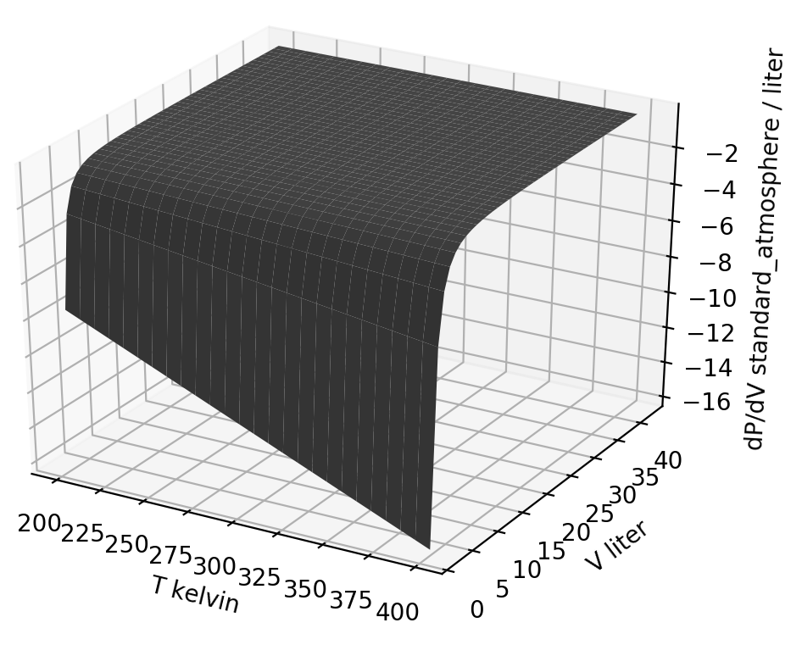
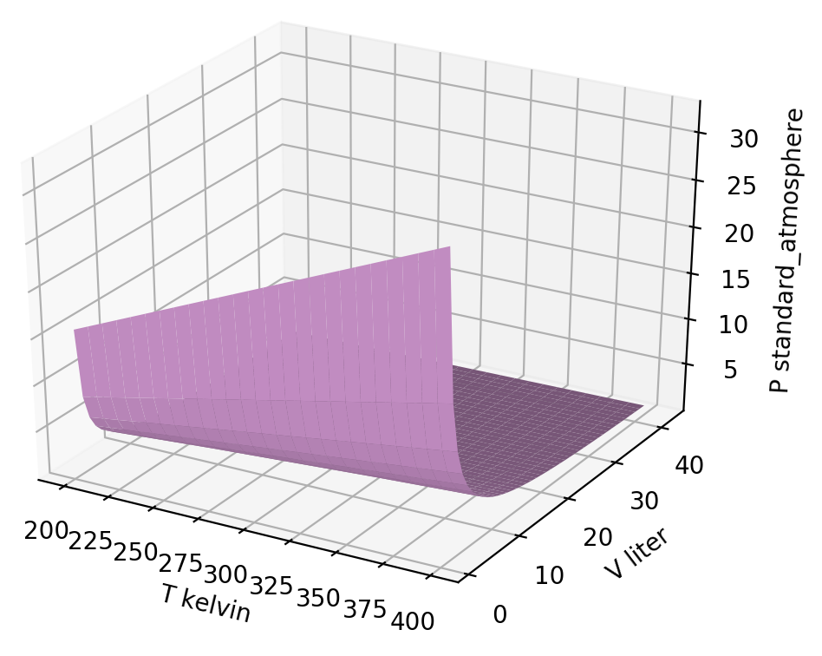
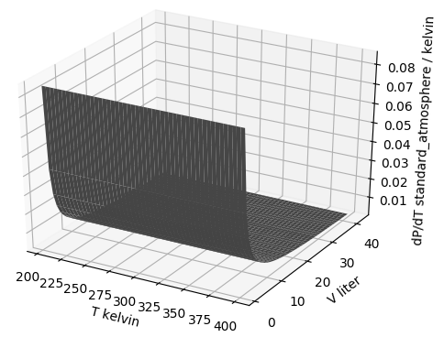



Thermodynamic surfaces of a gas - the big picture
${\left(\frac{∂P}{∂V}\right)}_{T}$
$$P\left(T,V\right)$$
${\left(\frac{∂P}{∂T}\right)}_{V}$

Slide 2
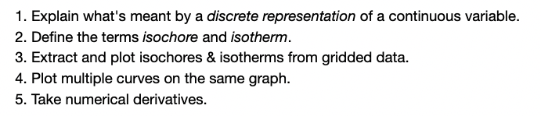
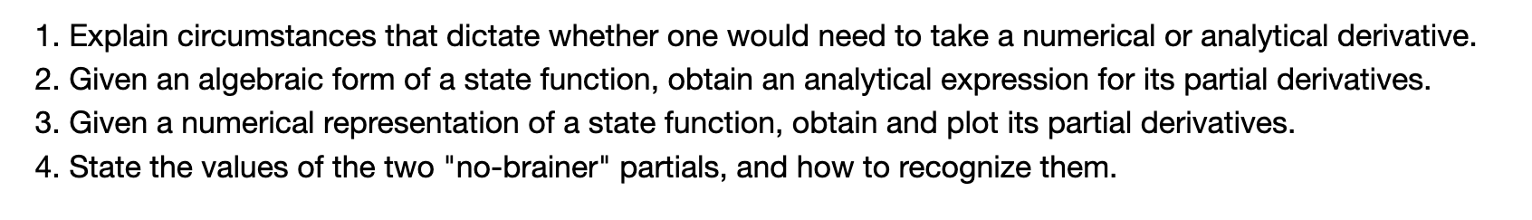
Thermodynamic surfaces of a gas - the details
Learning Goals (Wednesday)
Learning Goals (Thursday)

Slide 3
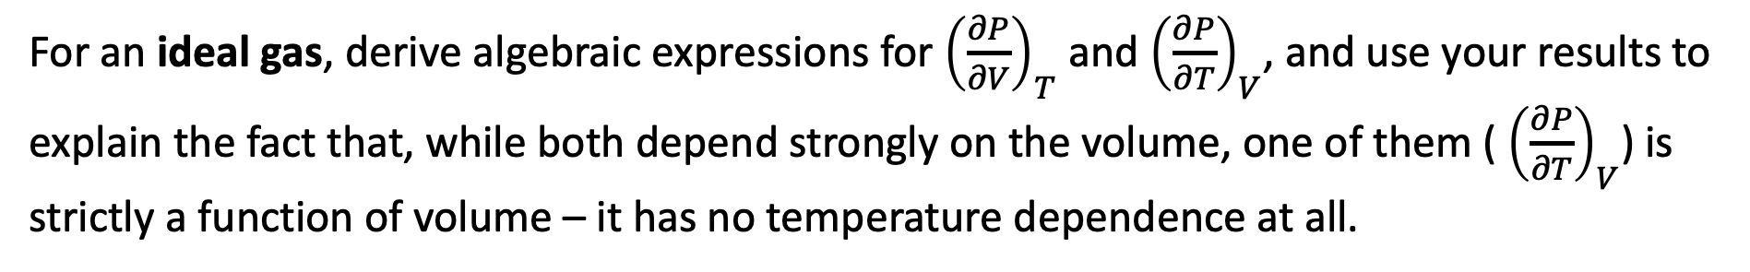
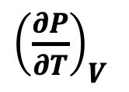
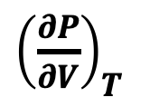
Analytical challenge #1
For an ideal gas, derive algebraic expressions for ${\left(\frac{∂P}{∂V}\right)}_{T}$ and ${\left(\frac{∂P}{∂T}\right)}_{V}$, and use your results to explain the fact that, while both depend strongly on the volume, one of them ( ${\left(\frac{∂P}{∂T}\right)}_{V}$) is strictly a function of volume – it has no temperature dependence at all.
${\left(\frac{∂P}{∂V}\right)}_{T}$
${\left(\frac{∂P}{∂T}\right)}_{V}$

Slide 4
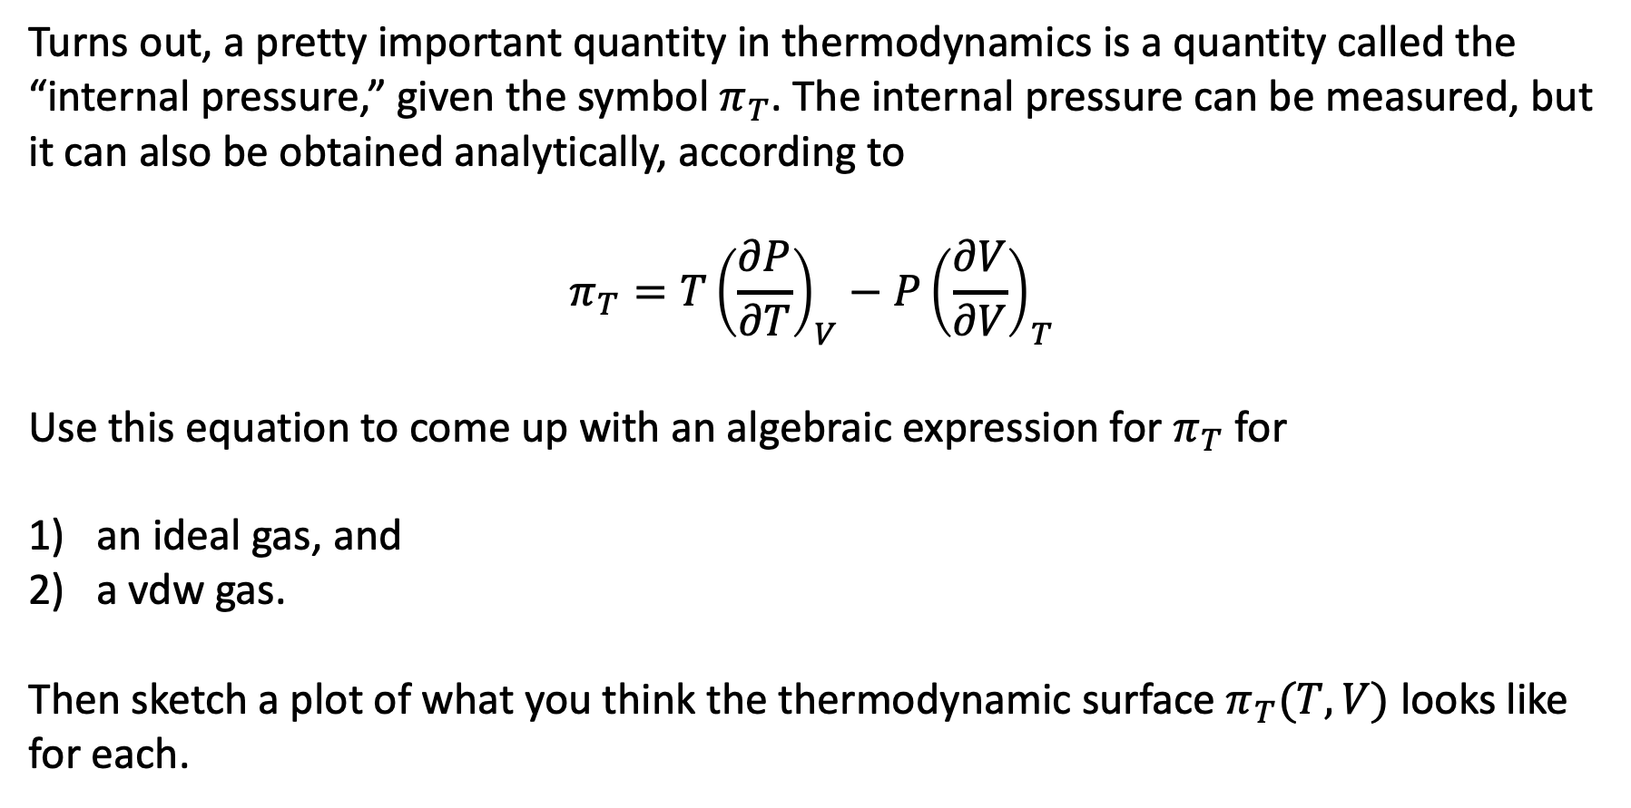
Analytical challenge #2
Turns out, a pretty important quantity in thermodynamics is a quantity called the “internal pressure,” given the symbol $π_{T}$. The internal pressure can be measured, but it can also be obtained analytically, according to
$$π_{T}=T{\left(\frac{∂P}{∂T}\right)}_{V}−P{\left(\frac{∂V}{∂V}\right)}_{T}$$
Use this equation to come up with an algebraic expression for $π_{T}$ for
an ideal gas, and
a vdw gas.
Then sketch a plot of what you think the thermodynamic surface $π_{T}(T,V)$ looks like for each.

